Slide 1

SRC CORPORATE DATA COMPARE
Presented by: Phil Schumacher
Revision: 27-Sep-2018

Slide 2
SRC POST2003 Workflow Overview
Signoff Step 1 - Signoff on GROUPS
*Purpose: SAMPLEID String match verification.
Accept 100% Ignore records (majority of Groups are 100% matched).
Assess all other GROUPS:
Use % Ignore, Min/Max/Avg Relative Difference:
*Look to the highest Group level(s) for a low % IGNORE correlation (HOLEID and GROUPID). Then look to the associated lowest Group level (SAMPLEID). Then look to Compare record level to assess if the string is matched correctly to the Corp. SAMPLEID based on how well the record level (SAMPLEID/NAME/VALUE) correlates.
Look for low % Ignore. Will have higher % New, % Update and % SME records at group aggregate level.
Look for large Relative differences (Min, Max, Avg) in SRC vs Corporate(P=1) values.
ACCEPT or REJECT.
Signoff Step 2 - Signoff on Bulk Records
IGNORE ALL INITIAL MAIN RECORDS.
IGNORE REJECTED GROUP RECORDS.
ELEMENT_METHOD_UNIT with NEW, UPDATE status where only one SRC_VALUE (no where else to go but in the DB if Group(s) are Accepted).
Signoff Step 3 - Signoff on Scenarios
ELEMENT_UNIT, ELEMENT only and SME Flags
*AT THIS STAGE - No matter the scenario, we have the tools and ability to individually select the record in question and signoff through means of UPDATE, IGNORE, NEW and allocate user ASSAYTYPE.
*This stage will require minor adjustments to further allow *Bulk signoff ability as further decisions are made on the scenarios.

Slide 3
SRC POST2003 SIGNOFF WORKFLOW
© 2018 PSGeoData Inc.

Slide 4
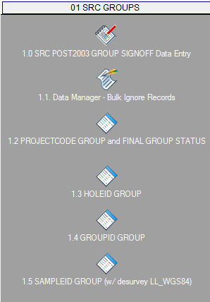
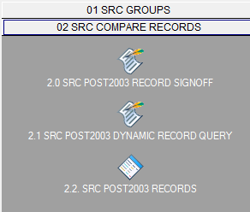
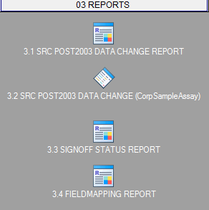
WORKSPACE TABS AND OBJECTS
© 2018 PSGeoData Inc.

Slide 5
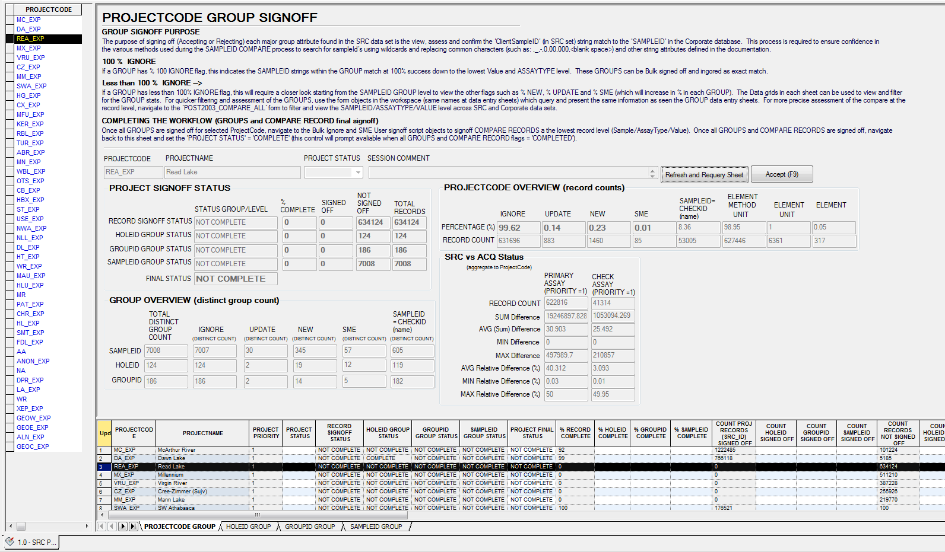
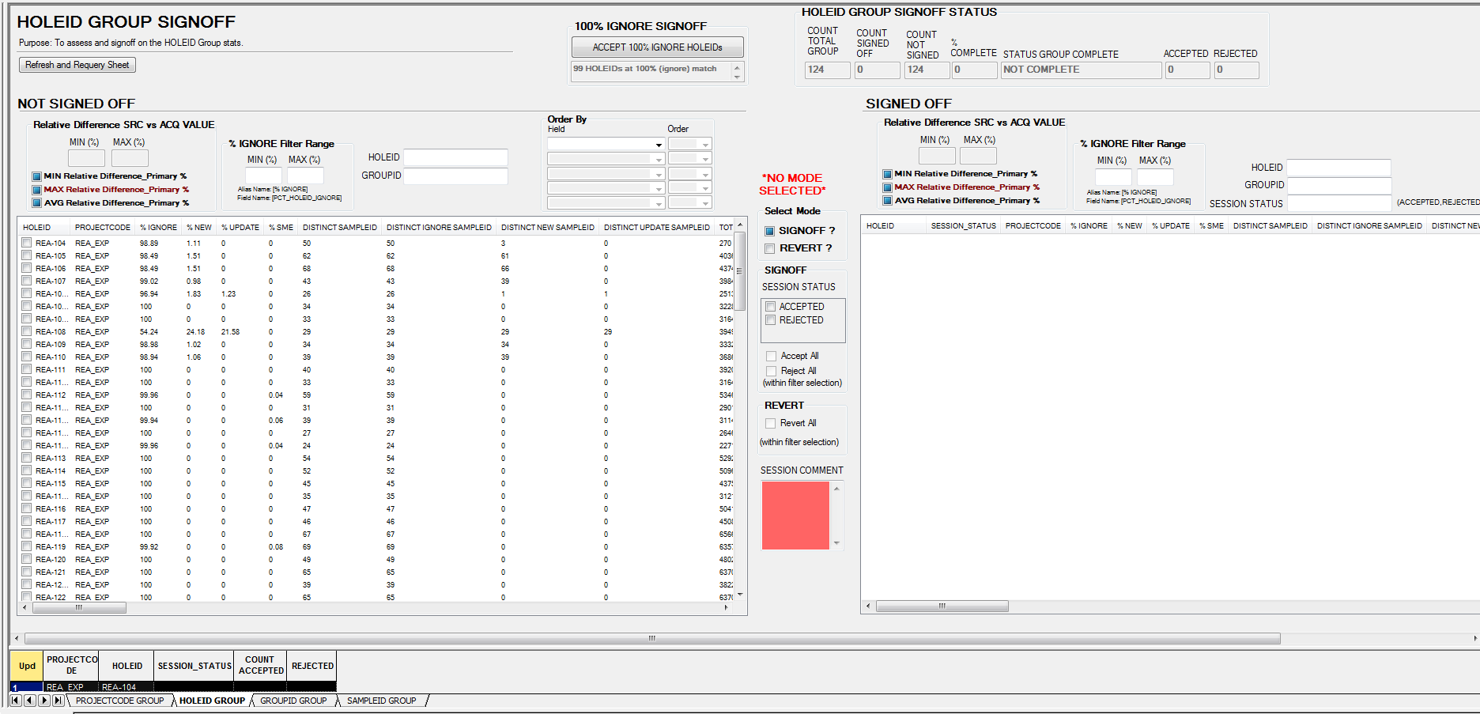
POST2003 SRC GROUP SIGNOFF DATA ENTRY
The GROUP Signoff Data Entry Tool will allow the user to assess and signoff on the SAMPLEID string match confidence.
GROUP LEVELS INCLUDE (highest to lowest):
PROJECTCODE
HOLEID
GROUPID (SRC Lab number)
SAMPLEID
Group % and counts for quick filtering of questionable groups.
Quick signoff of 100% IGNORE (all records matched in GROUP. Also the majority of group records found).
Stats: Min, Max, Avg Difference and Relative Difference of SRC vs Corp values and SRC vs SRC values for each GROUP level.
Dynamic filtering and data ordering to locate questionable groups.
*Look to the highest Group level(s) for a low % IGNORE correlation (HOLEID and GROUPID). Then look to the associated lowest Group level (SAMPLEID). Then look to Compare record level to assess if the string is matched correctly to the Corp. SAMPLEID based on how well the record level (SAMPLEID/NAME/VALUE) correlates.
© 2018 PSGeoData Inc.

Slide 6
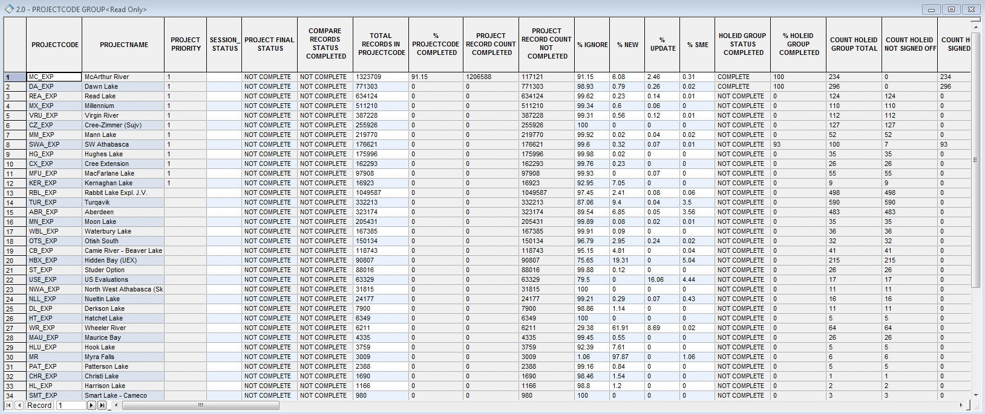
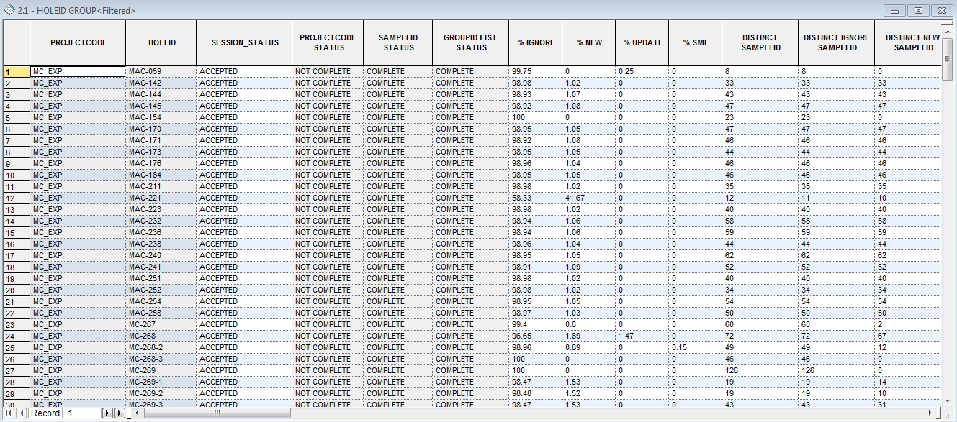
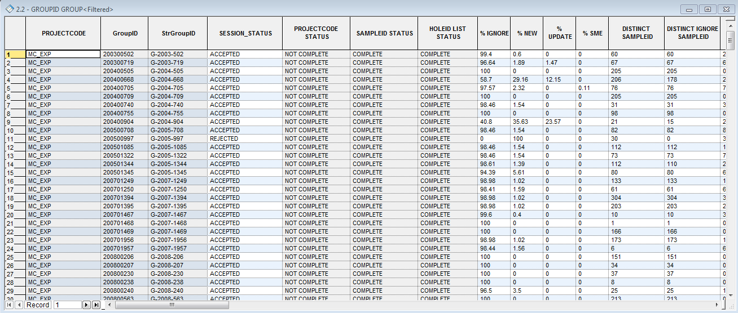
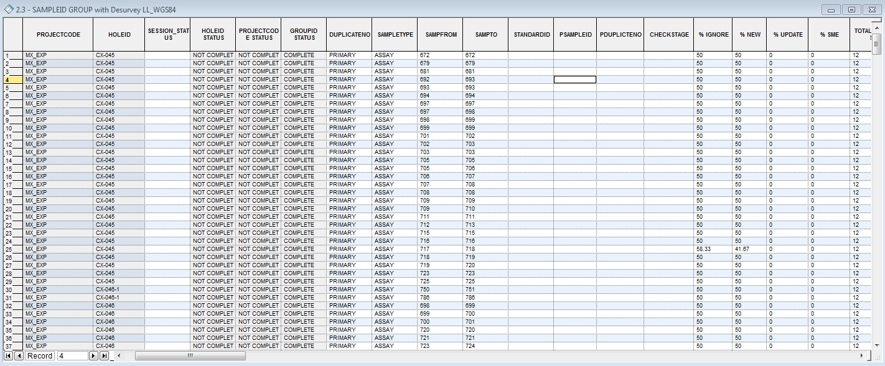
POST2003 SRC GROUP FORMS
PROJECTCODE GROUP (LEVEL 1)
HOLEID AND GROUPID GROUP (LEVEL 2)
SAMPLEID GROUP (LEVEL 2)
© 2018 PSGeoData Inc.

Slide 7
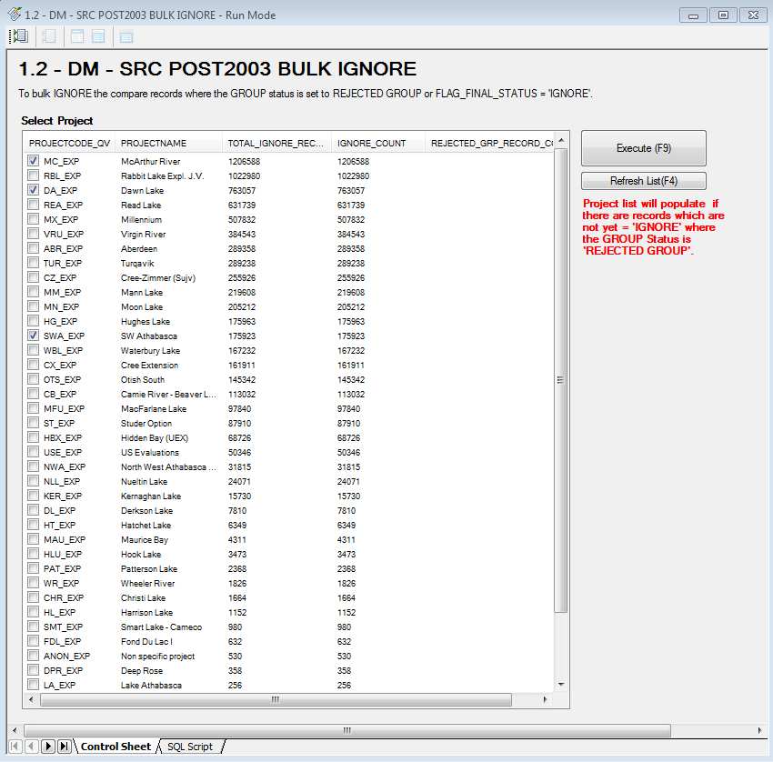
POST2003 SRC BULK DATA MANAGER SIGNOFF
The Bulk Data Manager Signoff Object script will be used to accomplish the following functions:
Bulk IGNORE the main compare records flagged as IGNORE:
Main compare ‘IGNORE’ records are from the first stage of compare where duplicates are found from the main pivot queries to compare all SRC combinations across the corporate values. These records account for more than 95% of the entire compare population.
Bulk IGNORE Compare Records where an associated GROUP has been REJCETED:
After using the GROUP Signoff Data Entry tool to assess the SAMPLEID string match, there may be REJECTED groups which subsequently reject all child compare records.
*More Bulk IGNORE, UPDATE, NEW and SME scenarios management will be added here as the user training and scenarios are assessed.
© 2018 PSGeoData Inc.

Slide 8
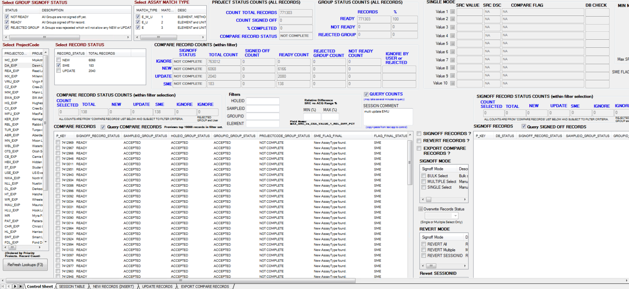
POST2003 SRC COMPARE RECORD SIGNOFF SCRIPT
The SRC Compare Record Signoff Script is the primary Signoff tool for the SME (Subject Matter Expert/Geologist) and Data Manager to INSERT (NEW), UPDATE (existing) or IGNORE SRC Compare records.
MODES
SIGNOFF MODE
BULK Select
Signoff within filter selection.
MULTIPLE Select
Signoff user list selected, cluster records of similar status.
SINGLE Select
Signoff individual records select where records have SME flags (new AssayType, change to IGNORE status or multiple SRC value selection).
REVERT MODE
Revert All
Revert all records within filter selection.
Revert Multiple Select
Revert Multiple
Revert user list selected, cluster records of similar status.
Revert SessionID
Revert by user SESSIONID (date, By, comment).
*More Bulk IGNORE, UPDATE, NEW and SME scenarios management will be added here as the user training and scenarios are assessed.
*GROUP LEVEL must be signed off before any compare records can be signed off here.
© 2018 PSGeoData Inc.

Slide 9
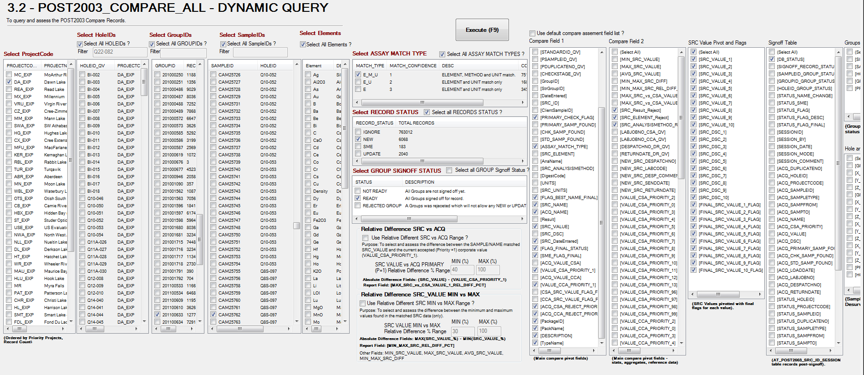
POST2003 SRC COMPARE DYANMIC QUERY
The SRC Compare Dynamic Query Script allows the user to run complex queries to help assess the GROUP status or COMPARE records status for signoff at either level.
Filter by ProjectCode, HoleID’s, GROUID’s, SAMPLEID’s, ELEMENT(s), ASSAY MATCH TYPE, RECORD STATUS, GROUP SIGNOFF STATUS and Relative Difference SRC vs Corp or SRC vs SRC (multiple values).
Field names from all stages of the Compare process can be dynamically added for user viewing.
© 2018 PSGeoData Inc.

Slide 10
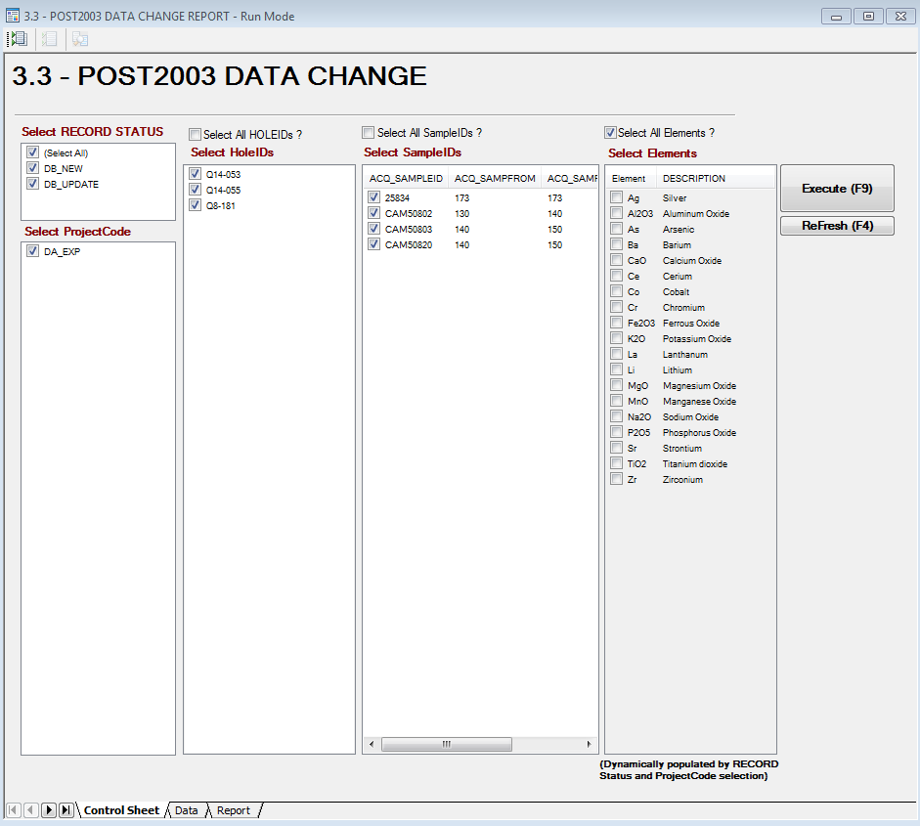
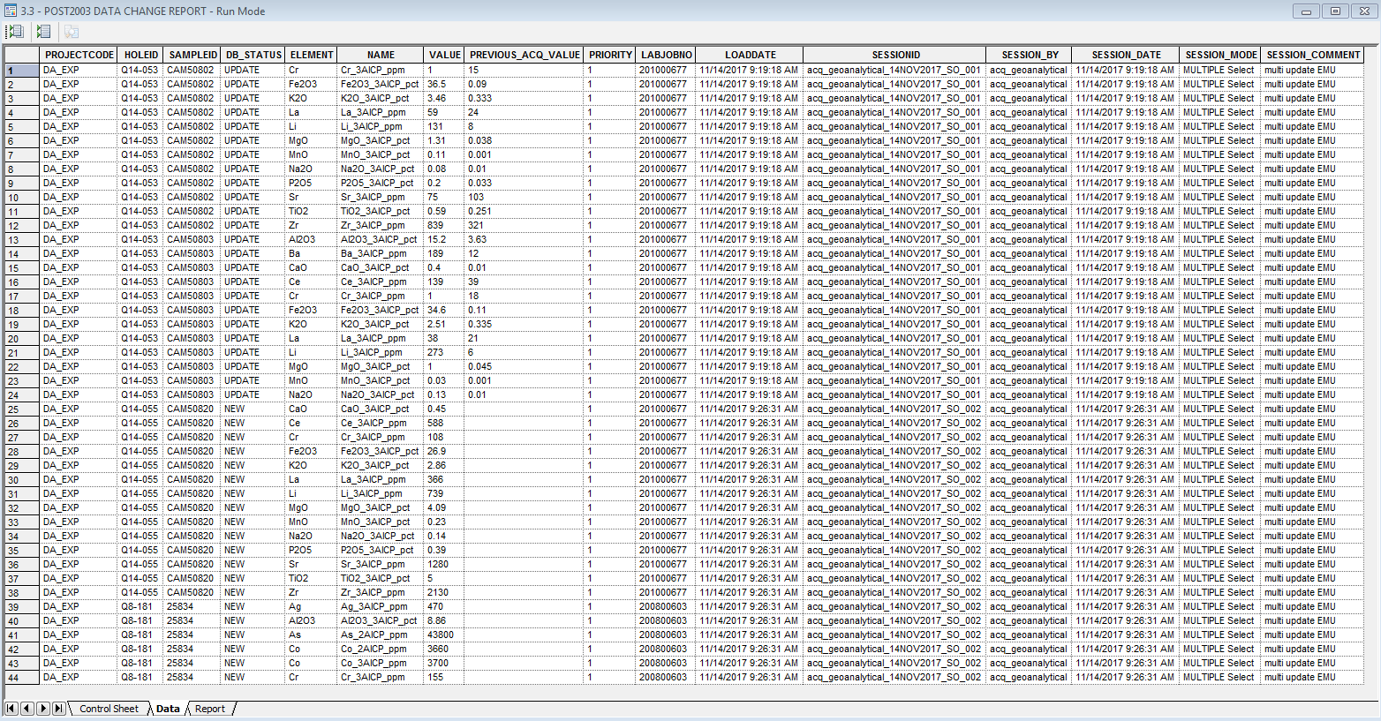
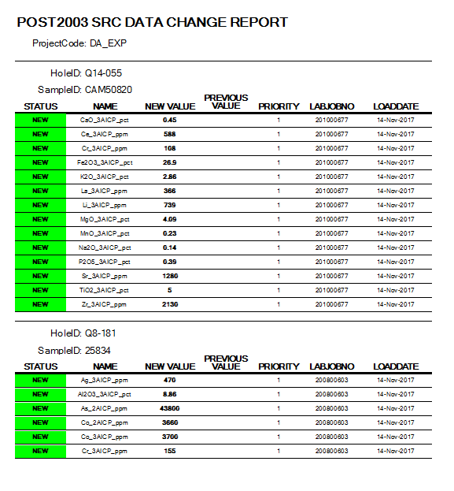
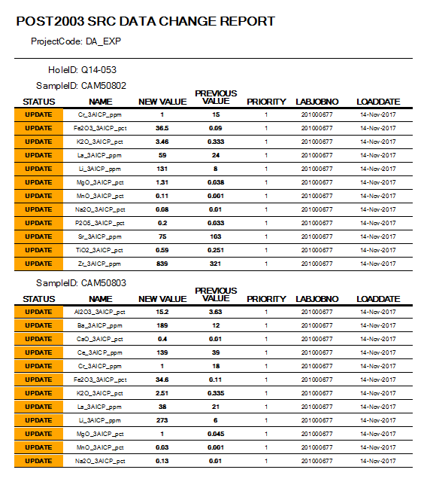
POST2003 SRC DATA CHANGE REPORT
The DATA CHANGE REPORT allows the user to report on any SRC POST2003 data which has been UPDATED or INSERTED (NEW). These reports will only query the SRC POST2003 data changed.
DATA CHANGE REPORT (REPORT OBJECT)
DATA CHANGE REPORT FORM
(DERIVED LOOK AT DIRECTLY CORPSAMPLEASSAY)
© 2018 PSGeoData Inc.

Slide 11
OTHER REPORTS (In Progress)
FIELD MAPPING REPORT
Comprehensive field descriptions for all POST2003 tables involved in the signoff process.
PROJECT SIGNOFF REPORT
All stats and Signoff Status all each level (Similar to PROJECTCODE GROUP form with added stats and visuals (charts and tables) for quicker assessment.
© 2018 PSGeoData Inc.

Slide 12
SCENARIOS
McArthur River (MC_EXP)
U values
'2406','2382’ - value (3AICP) UPDATE where E_M_U match and large value difference (SRC 117000 vs 13 acq)
'CAM094757’ - U_ICPMS3A_ppm multi value update SME flag.
'CAM47208' - New U values (E_U_ match example) '744' --New U value (E only, no ACQ_NAME) U_2AICP_ppm,20000 ---E_M_U updates '1623' --hole: MC-289, Abs update EMU, (only if group check passes) '1639’ ---P=C ABS update (only if group check passes).
'04MC2703G023A’ – Primary=Check string. Absolute NEW record (only if group check passes).
*Add condition found (11/14/2017): Multiple NEW, need to select which value and what to do with other.
'29921' - Primary=Check string. Absolute NEW record (only if group check passes).
'CAM47205'- Primary=Check string. Absolute NEW record (only if group check passes).
DAWN LAKE (DA_EXP)
'03Q22082G029'-Element not matching
'CAM25762’ - Primary=Check string
'03Q11A026G001' --New U values.
'04Q22092G034' --U values
'25851' -- new U3O8
© 2018 PSGeoData Inc.

Slide 13
SRC POST2003 COMPARE RECORD SIGNOFF - DATA FLOW
© 2018 PSGeoData Inc.

Slide 14
NEXT STEPS
DEVELOPMENT ENVIRONMENT
FUTURE PHASE
Scan remaining data sets where SAMPLEID could not be identified.
Run sql algorithms for aggregate data match to existing Sample data.
Locate possible and probable of SampleID and Dispatch data set match at each level (Project, HoleID, LabJobno, SampleID).
Potential PSG Machine Learning exercise in conjunction with linear sql algorithms.
TASK | ESTIMATED TIME (1 day = 8 hours)
User Training, Testing and Scenarios Insert or update records. Revert data if necessary at any point using tools. | 4.0
Workflow object updates Identify quicker Bulk Signoff for NEW, UPDATE and SME records. Identify and fix workflow bottlenecks and show stoppers. | 4.0
Move to Production Environment Insert or update records. Revert data if necessary at any point using tools. | 2.5
Documentation updates | 0
© 2018 PSGeoData Inc.

